Slide 1

ELECTRONICS 101
OHM’S LAW

Slide 2


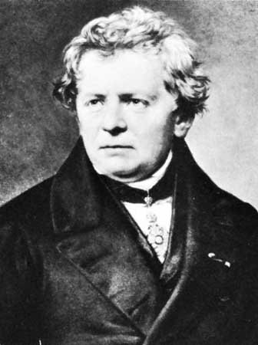
HISTORY OF OHM’S LAW
Discovered by a German Physicist named Goerg Ohm
He believes that the current through the conductor is
proportional to voltage

Slide 3
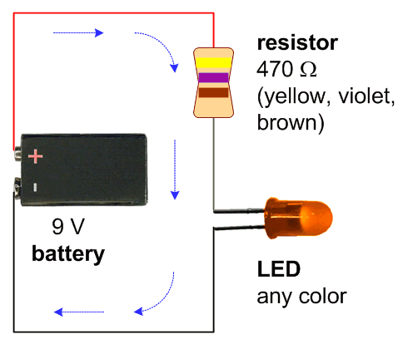
OHM’S LAW EQUATION
V = IR
V - Voltage
I - Current
R - Resistance (Constant unless
there is a potentiometer)
Alternatively, I = V/R and R = V/I
The higher the resistance, the lower the current
The lower the resistance, the higher the current

Slide 4
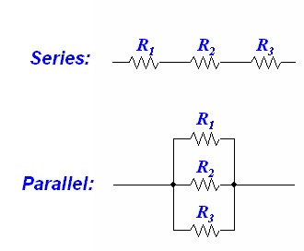
VOLTAGE AND CURRENT EQUIVALENCE
Current is equal when resistors are in series
Voltage splits and goes down
Voltage is equal when resistors are parallel
Current splits and join at the end

Slide 5
EXAMPLE
Say you have 220 ohms resistor and 9V battery
Calculate the current flowing through the conductor
Use Ohm’s Law V = IR
Plugging in the values, you get 9 = I * 220
Using Algebra, you get I = 9/220
Finally through division, you get I = .0409A or I = 40.9 mA
Will 40.9mA be enough burn a ¼ (.25) W resistor?
P = 9 * .0409 = .368 W or 368mW
Maybe...

Slide 6
EXAMPLE WITH LED
Say you have 220 ohms resistor, 15 ohms LED and 9V battery
Calculate the current flowing through the conductor
Add 220 ohms and 15 ohms together since they are in series
You get 235 ohm’s altogether
Use Ohm’s Law V = IR
Plugging in the values, you get 9 = I * 235
Using Algebra, you get I = 9/235
Finally through division, you get I = .0383A or I = 38.3mA
Will 38.3mA be enough burn a ¼ (.25) W resistor?
P = 9 * .0383 = .3447W or 344.7mW
Maybe...

